Slide 1
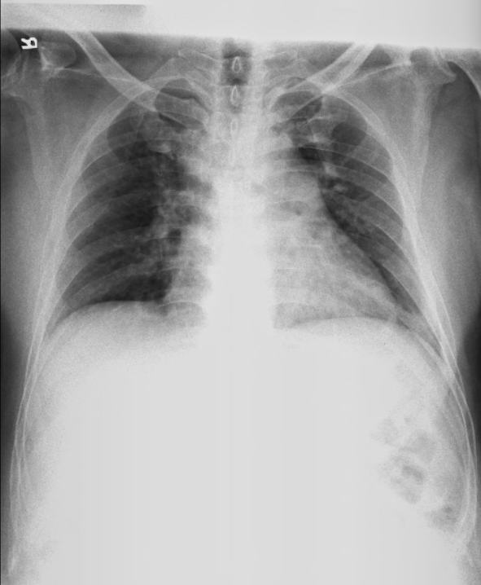
PATIENT INFO
PATIENT INFO
PATIENT INFO
PATIENT INFO
PATIENT INFO
PATIENT INFO
ABNORMAL
 | Findings |  | Result
 | Cardiomegaly | 0.6 | Yes
 | Blunted CP RIGHT | 110° | Yes
 | Blunted CP LEFT | 4° | No
 | Hilar | 44% | No
 | Pneumothorax | 88% | Yes
 | Consolidation | 99% | Yes
 | Pleural Effusion | 11% | No
 | GGO | 22% | No
 | Fibrosis | 33% | No
 | Nodule | 77% | Yes
Cardiomegaly Value is Cardiothoracic Ratio.
Value<0.5 = no | Value>0.5 = YES
Blunted CP Angle Value is in Degree.
Value<80° = NO | Value>80° = YES
PATIENT INFO
PATIENT INFO

